Slide 1
State of the City
Mayor Brodeur February 27, 2023

Slide 2
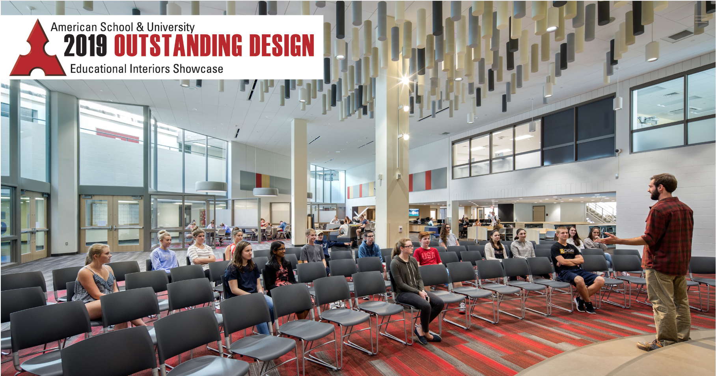

Slide 3
The State of the City of Melrose IS
VIBRANT
COMMITTED
CONNECTED
INVESTED
GENEROUS

Slide 4
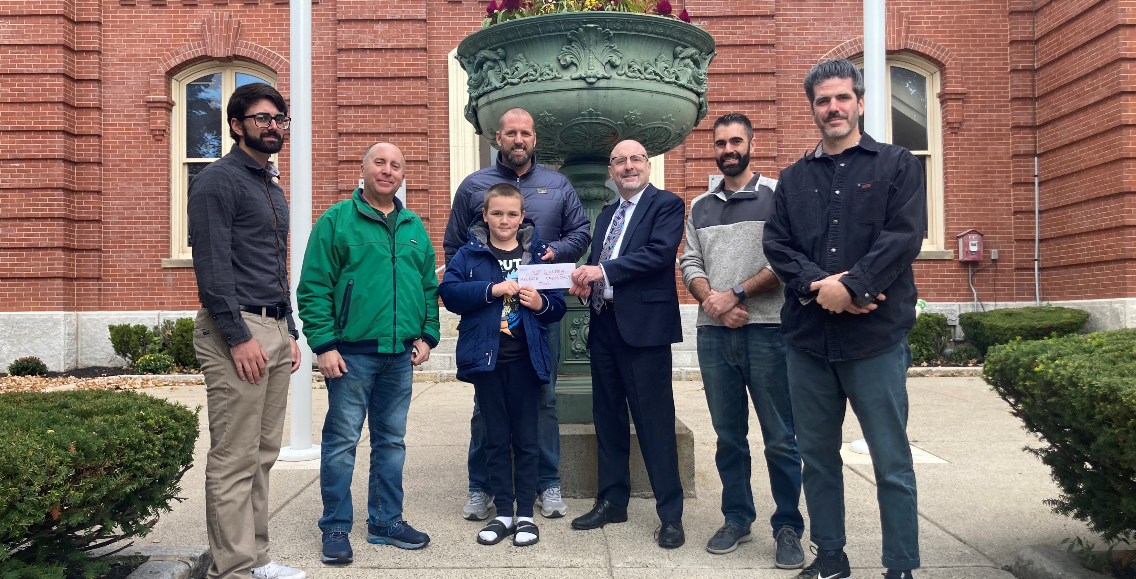

Slide 5
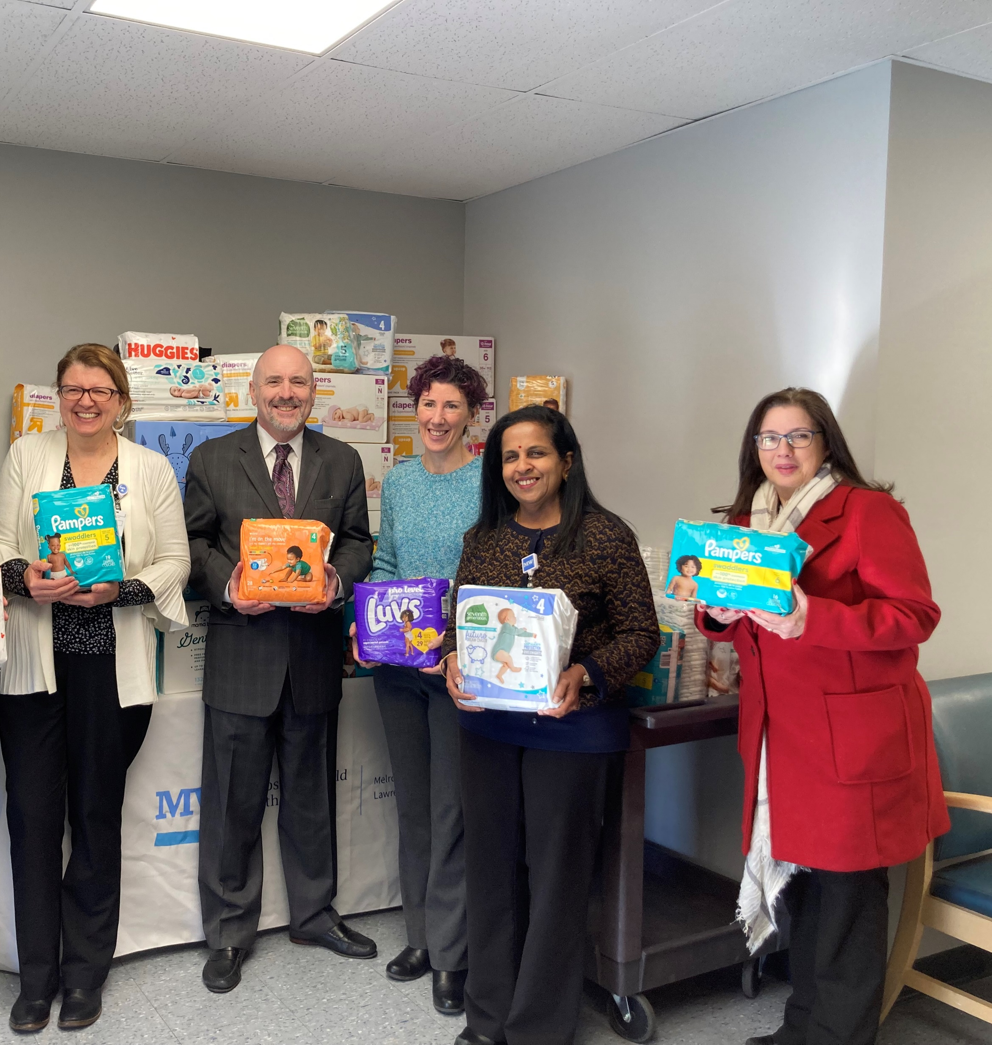
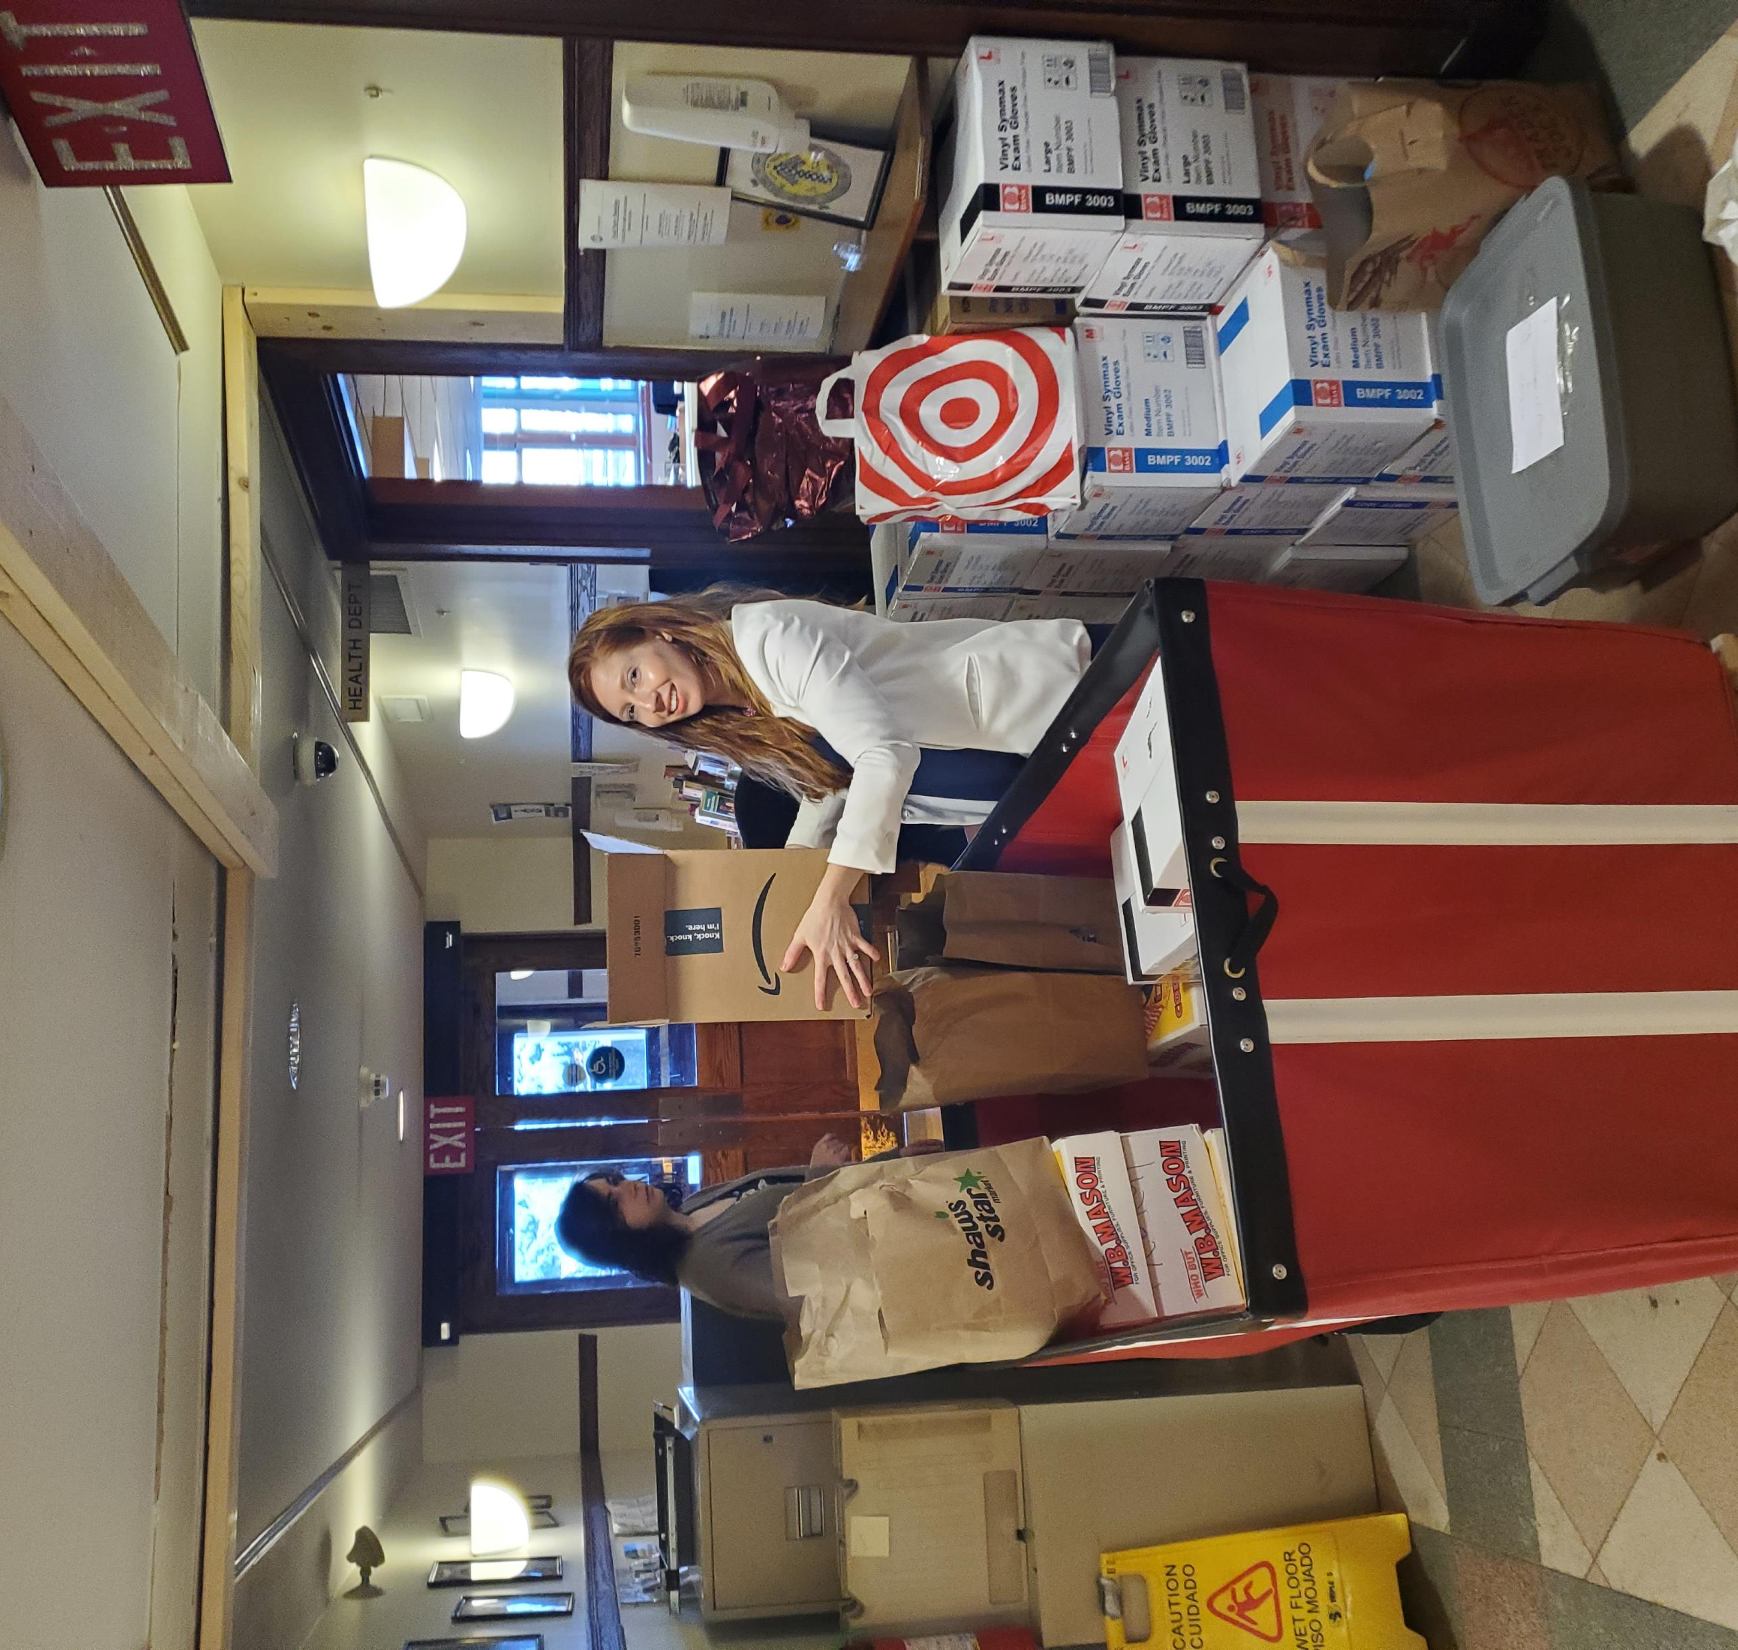

Slide 7
The good we’ve done together

Slide 8
In 2022 We Came Together Again
MSO Performances
City-Wide Art Show
White Ribbon Day
Healthy Melrose
Memorial Day
Juneteenth
Pride
Summer Stroll
Kindergarten Welcome
Porchfest
Victorian Fair
Senior Resource Fair
Dance for Community
Downtown Trick-or-Treat
Home for the Holidays
4th of July

Slide 9
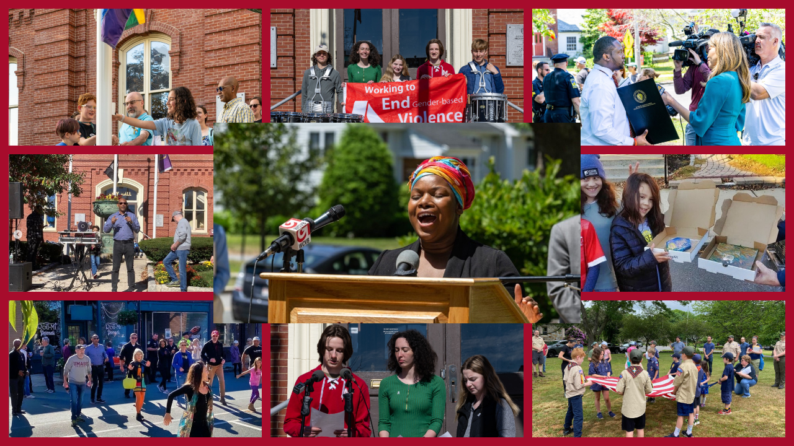

Slide 10
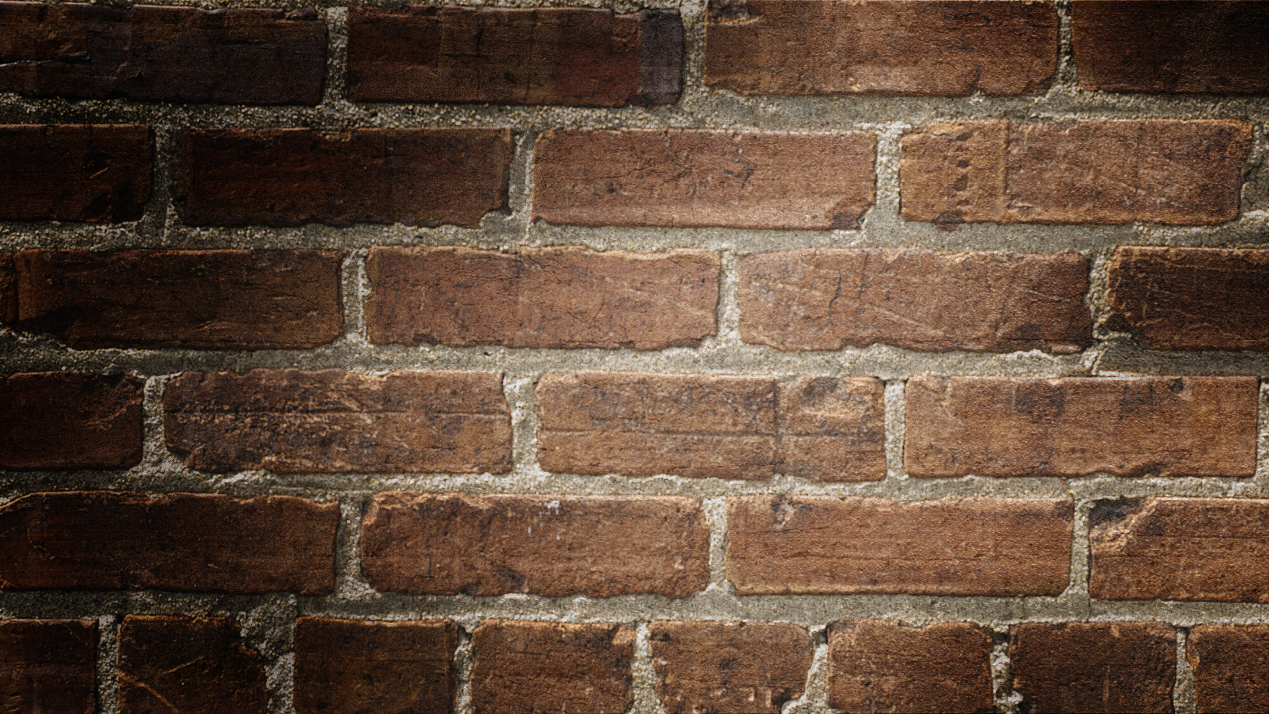
In 2022, We focused on Community Health & Wellness

Slide 11
We met social service needs
171 RESIDENTS RECEIVED INFORMATION AND CONSULTATION ON BEST FITTING SERVICES
105 RESIDENTS RECEIVED IN-DEPTH RECURRENT SUPPORT IN ACCESSING/NAVIGATING SOCIAL & MENTAL HEALTH SERVICES
126 RESIDENTS RECEIVED COORDINATION OF INITIAL REFERRALS FOR SPECIFIC SERVICES

Slide 12
Youth & adult mental Health first aid training

Slide 15
$3.3 Million ARPA funds allocated to Schools budget stabilization AND infrastructure including:
HS elevators
Middle school Air conditioning
Franklin school windows
SCHOOLS (46%)

Slide 16
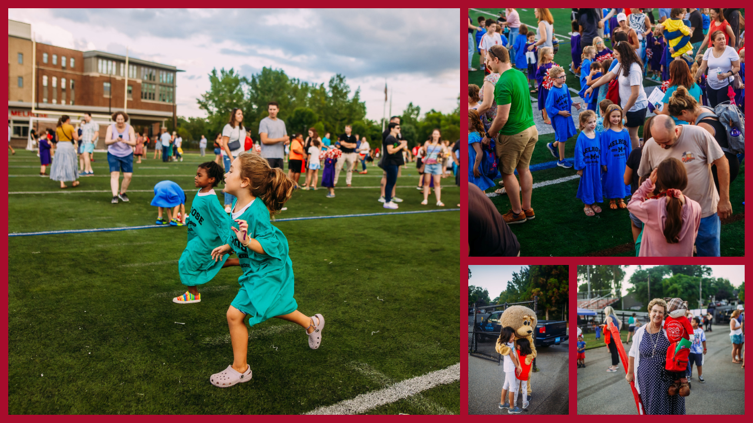

Slide 17
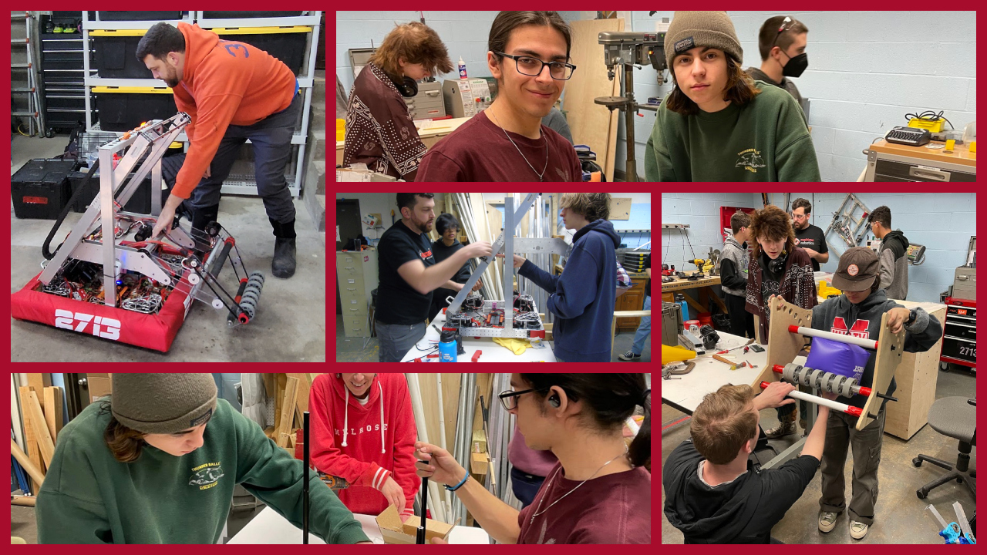
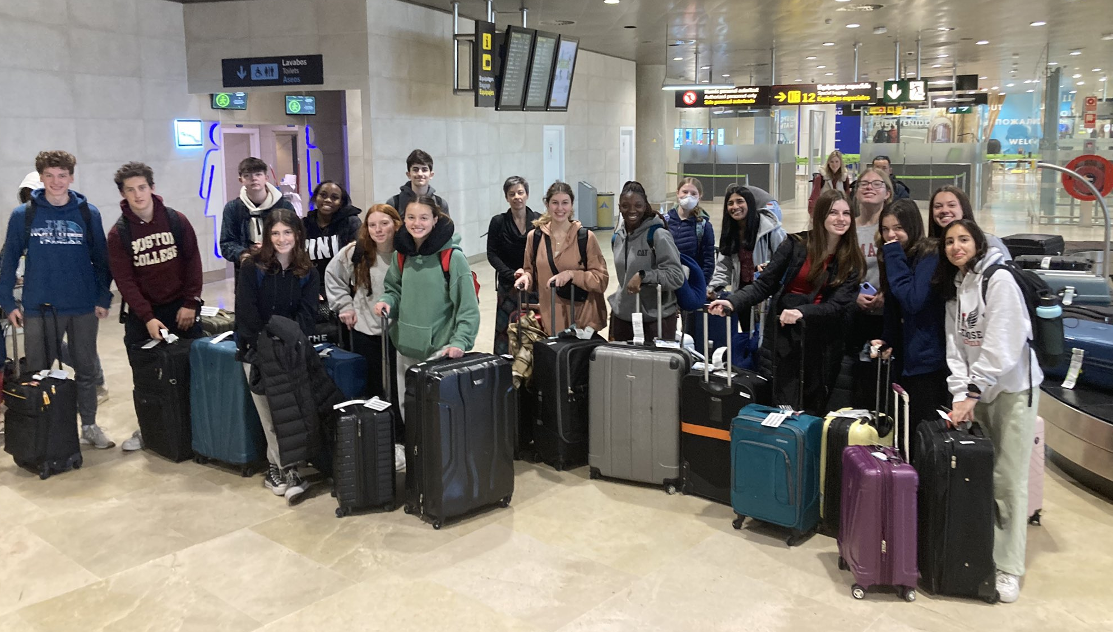
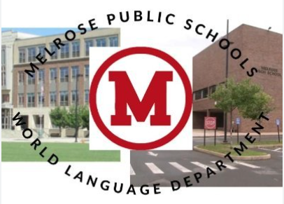

Slide 18
In 2022 We supported older adults
Milano Center upgrades: HVAC and Patio Pavilion
Age- and Dementia-Friendly Community
Senior Tax and Fee Deferral Programs

Slide 19
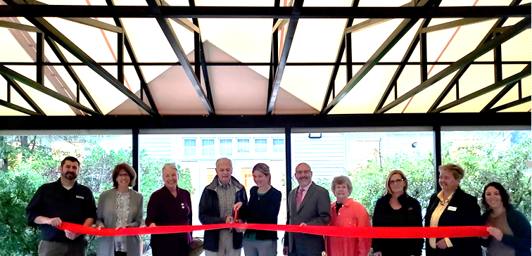

Slide 20
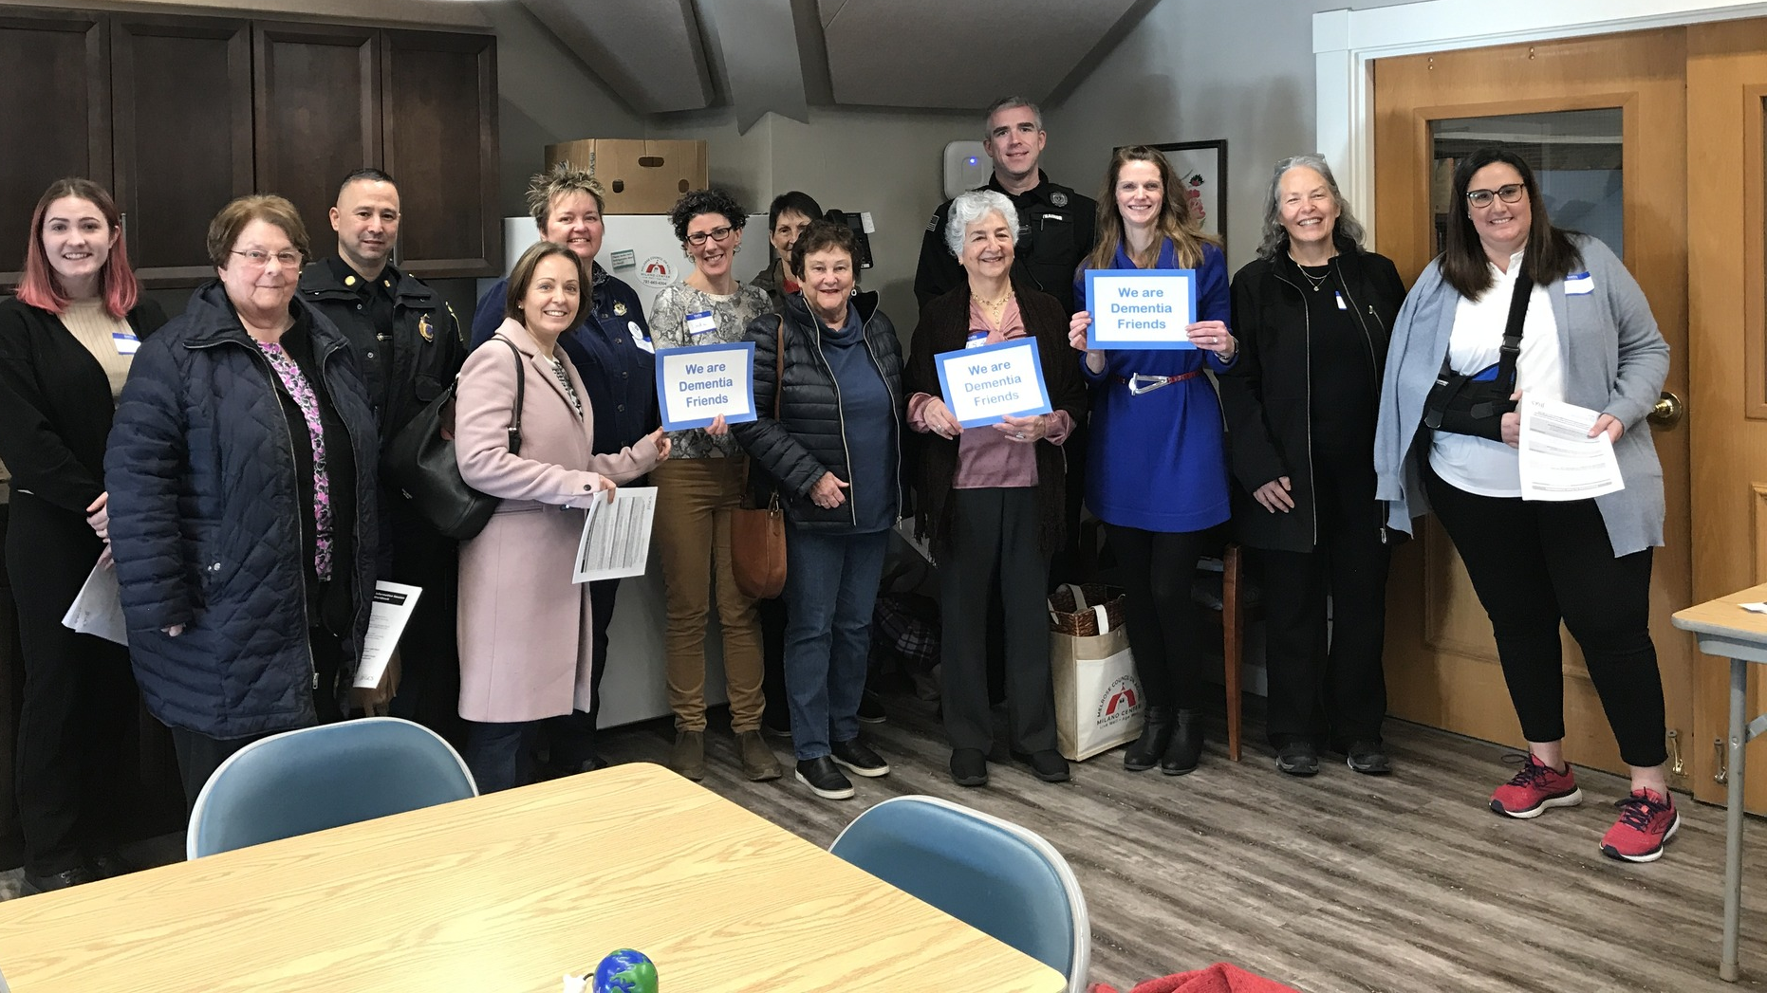
Dementia Friends training

Slide 22
In 2022 we worked to become a more inclusive community
DEI Equity Audit and Trainings
ADA Self Assessment and Transition Plan
Community Conversations to Promote Civic Dialog

Slide 23
In 2022 We supported our small businesses and non-profits

Slide 24
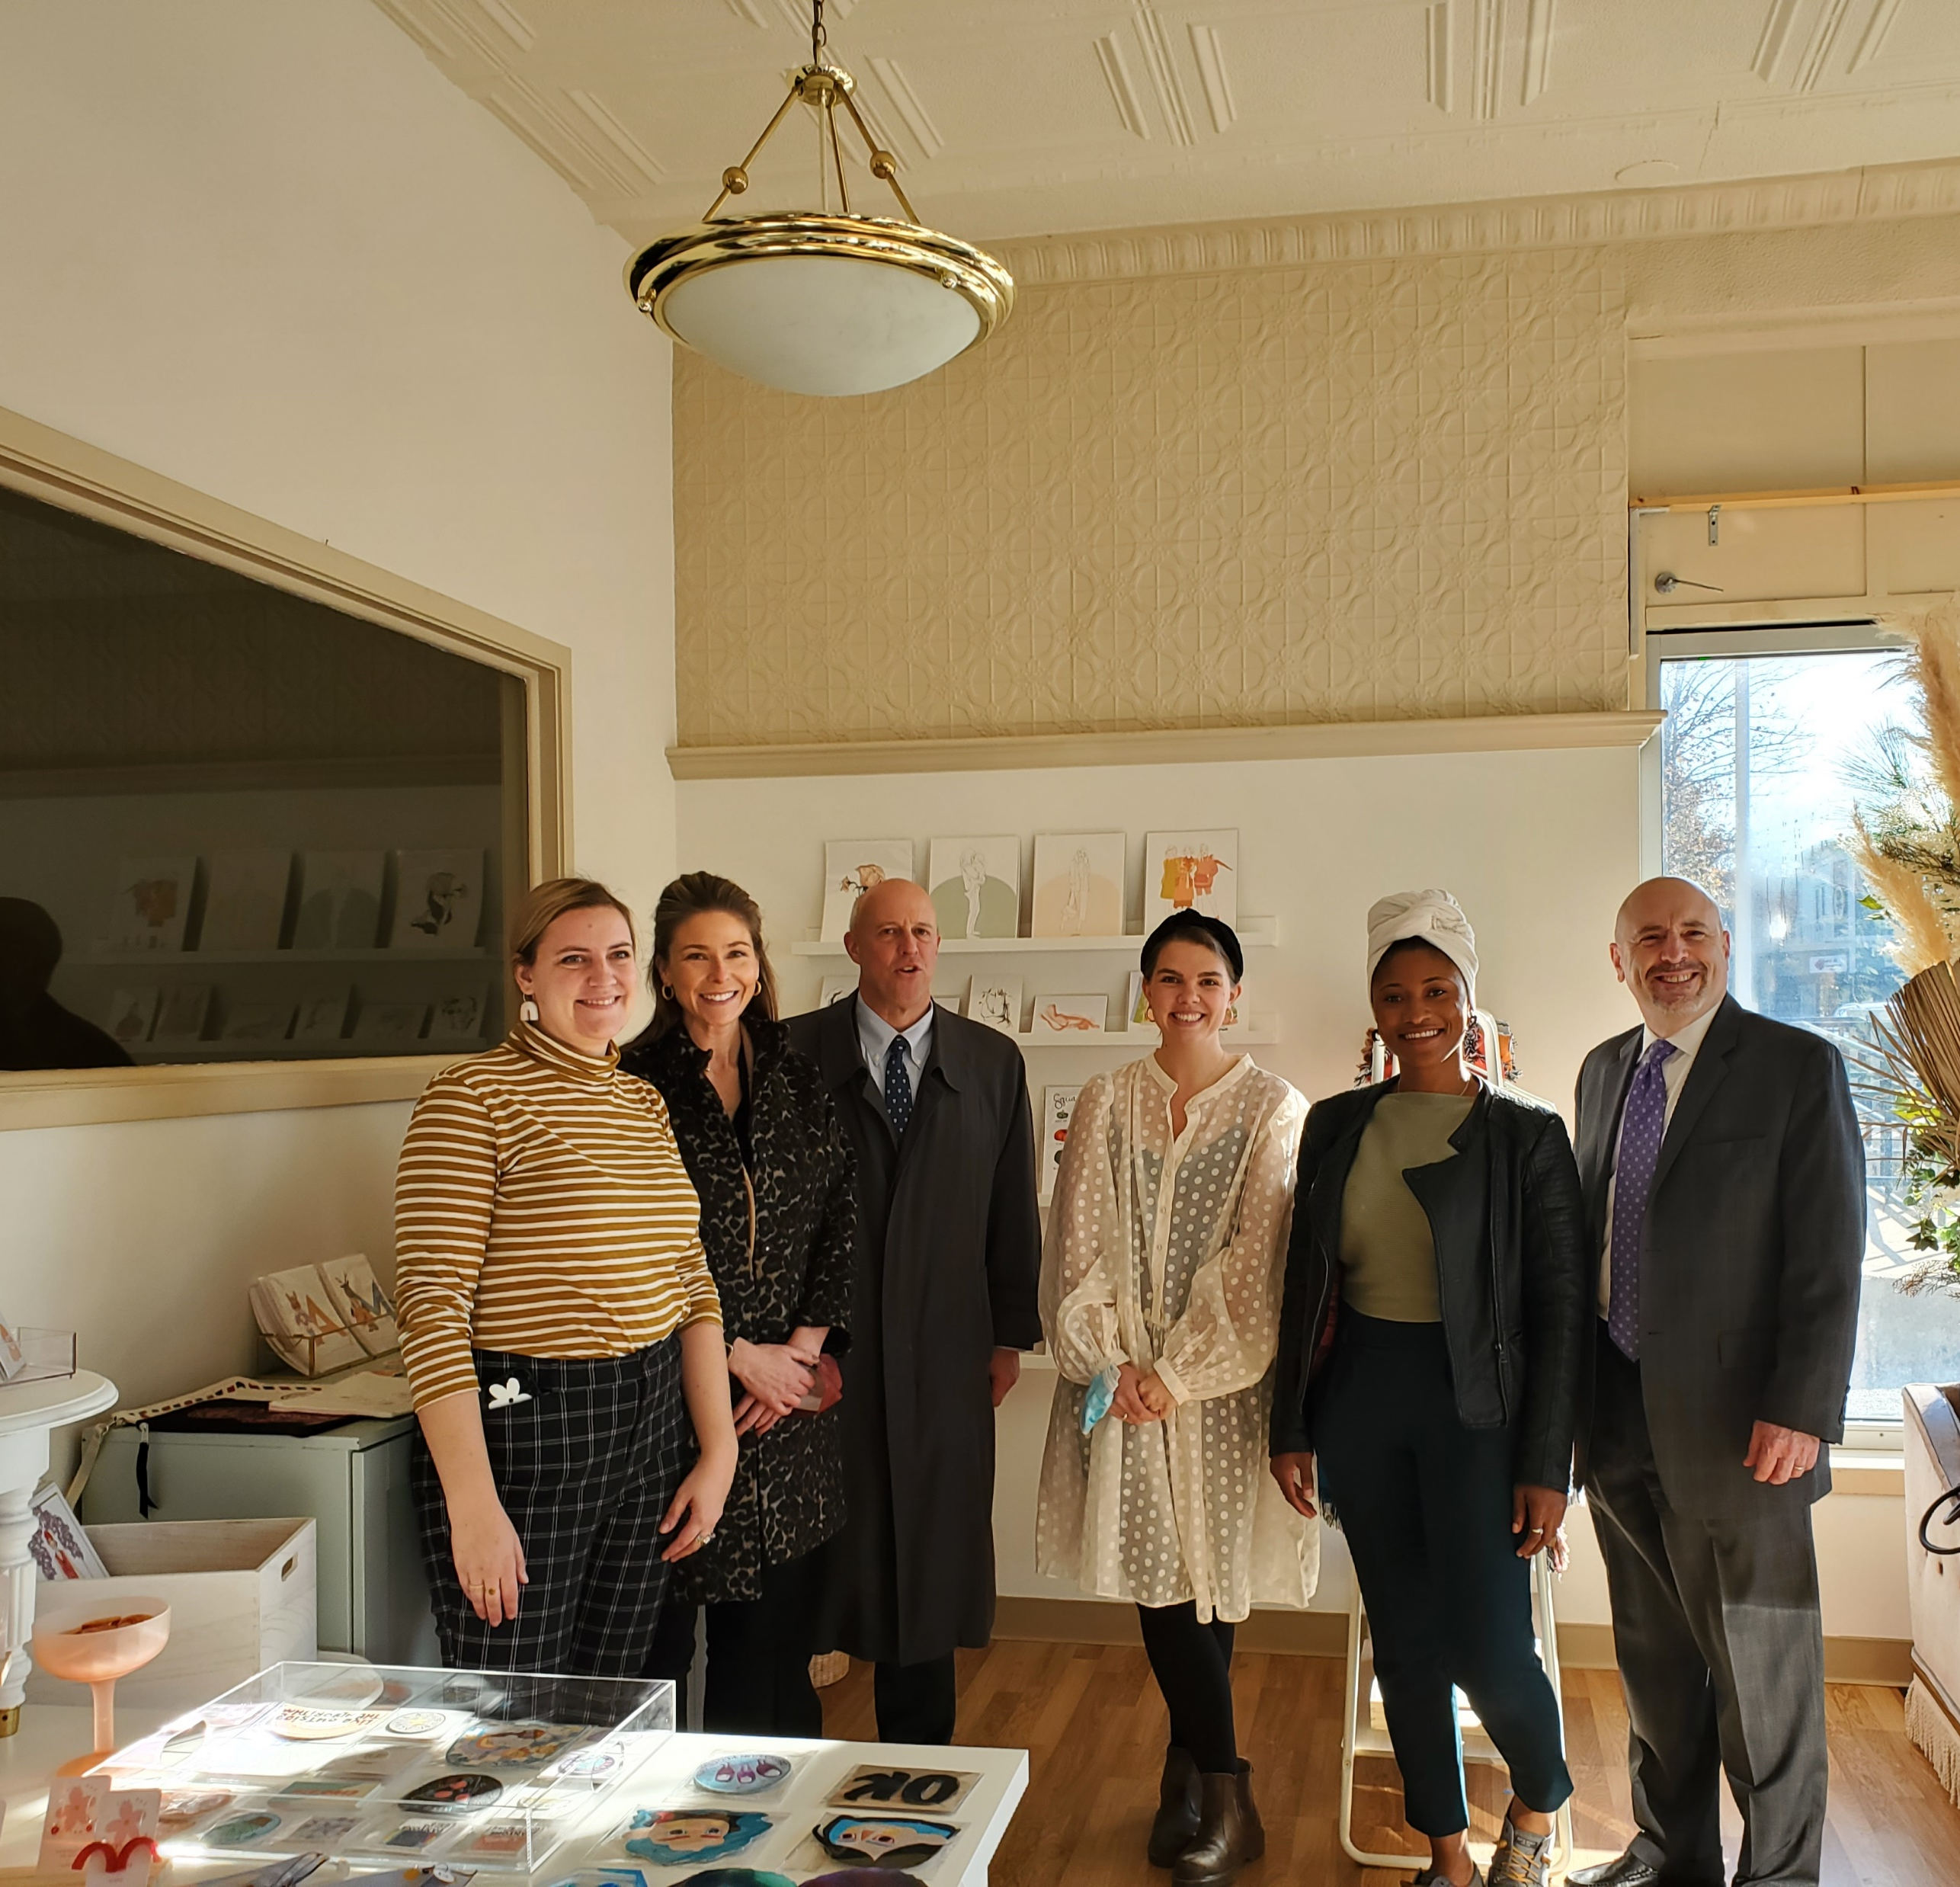
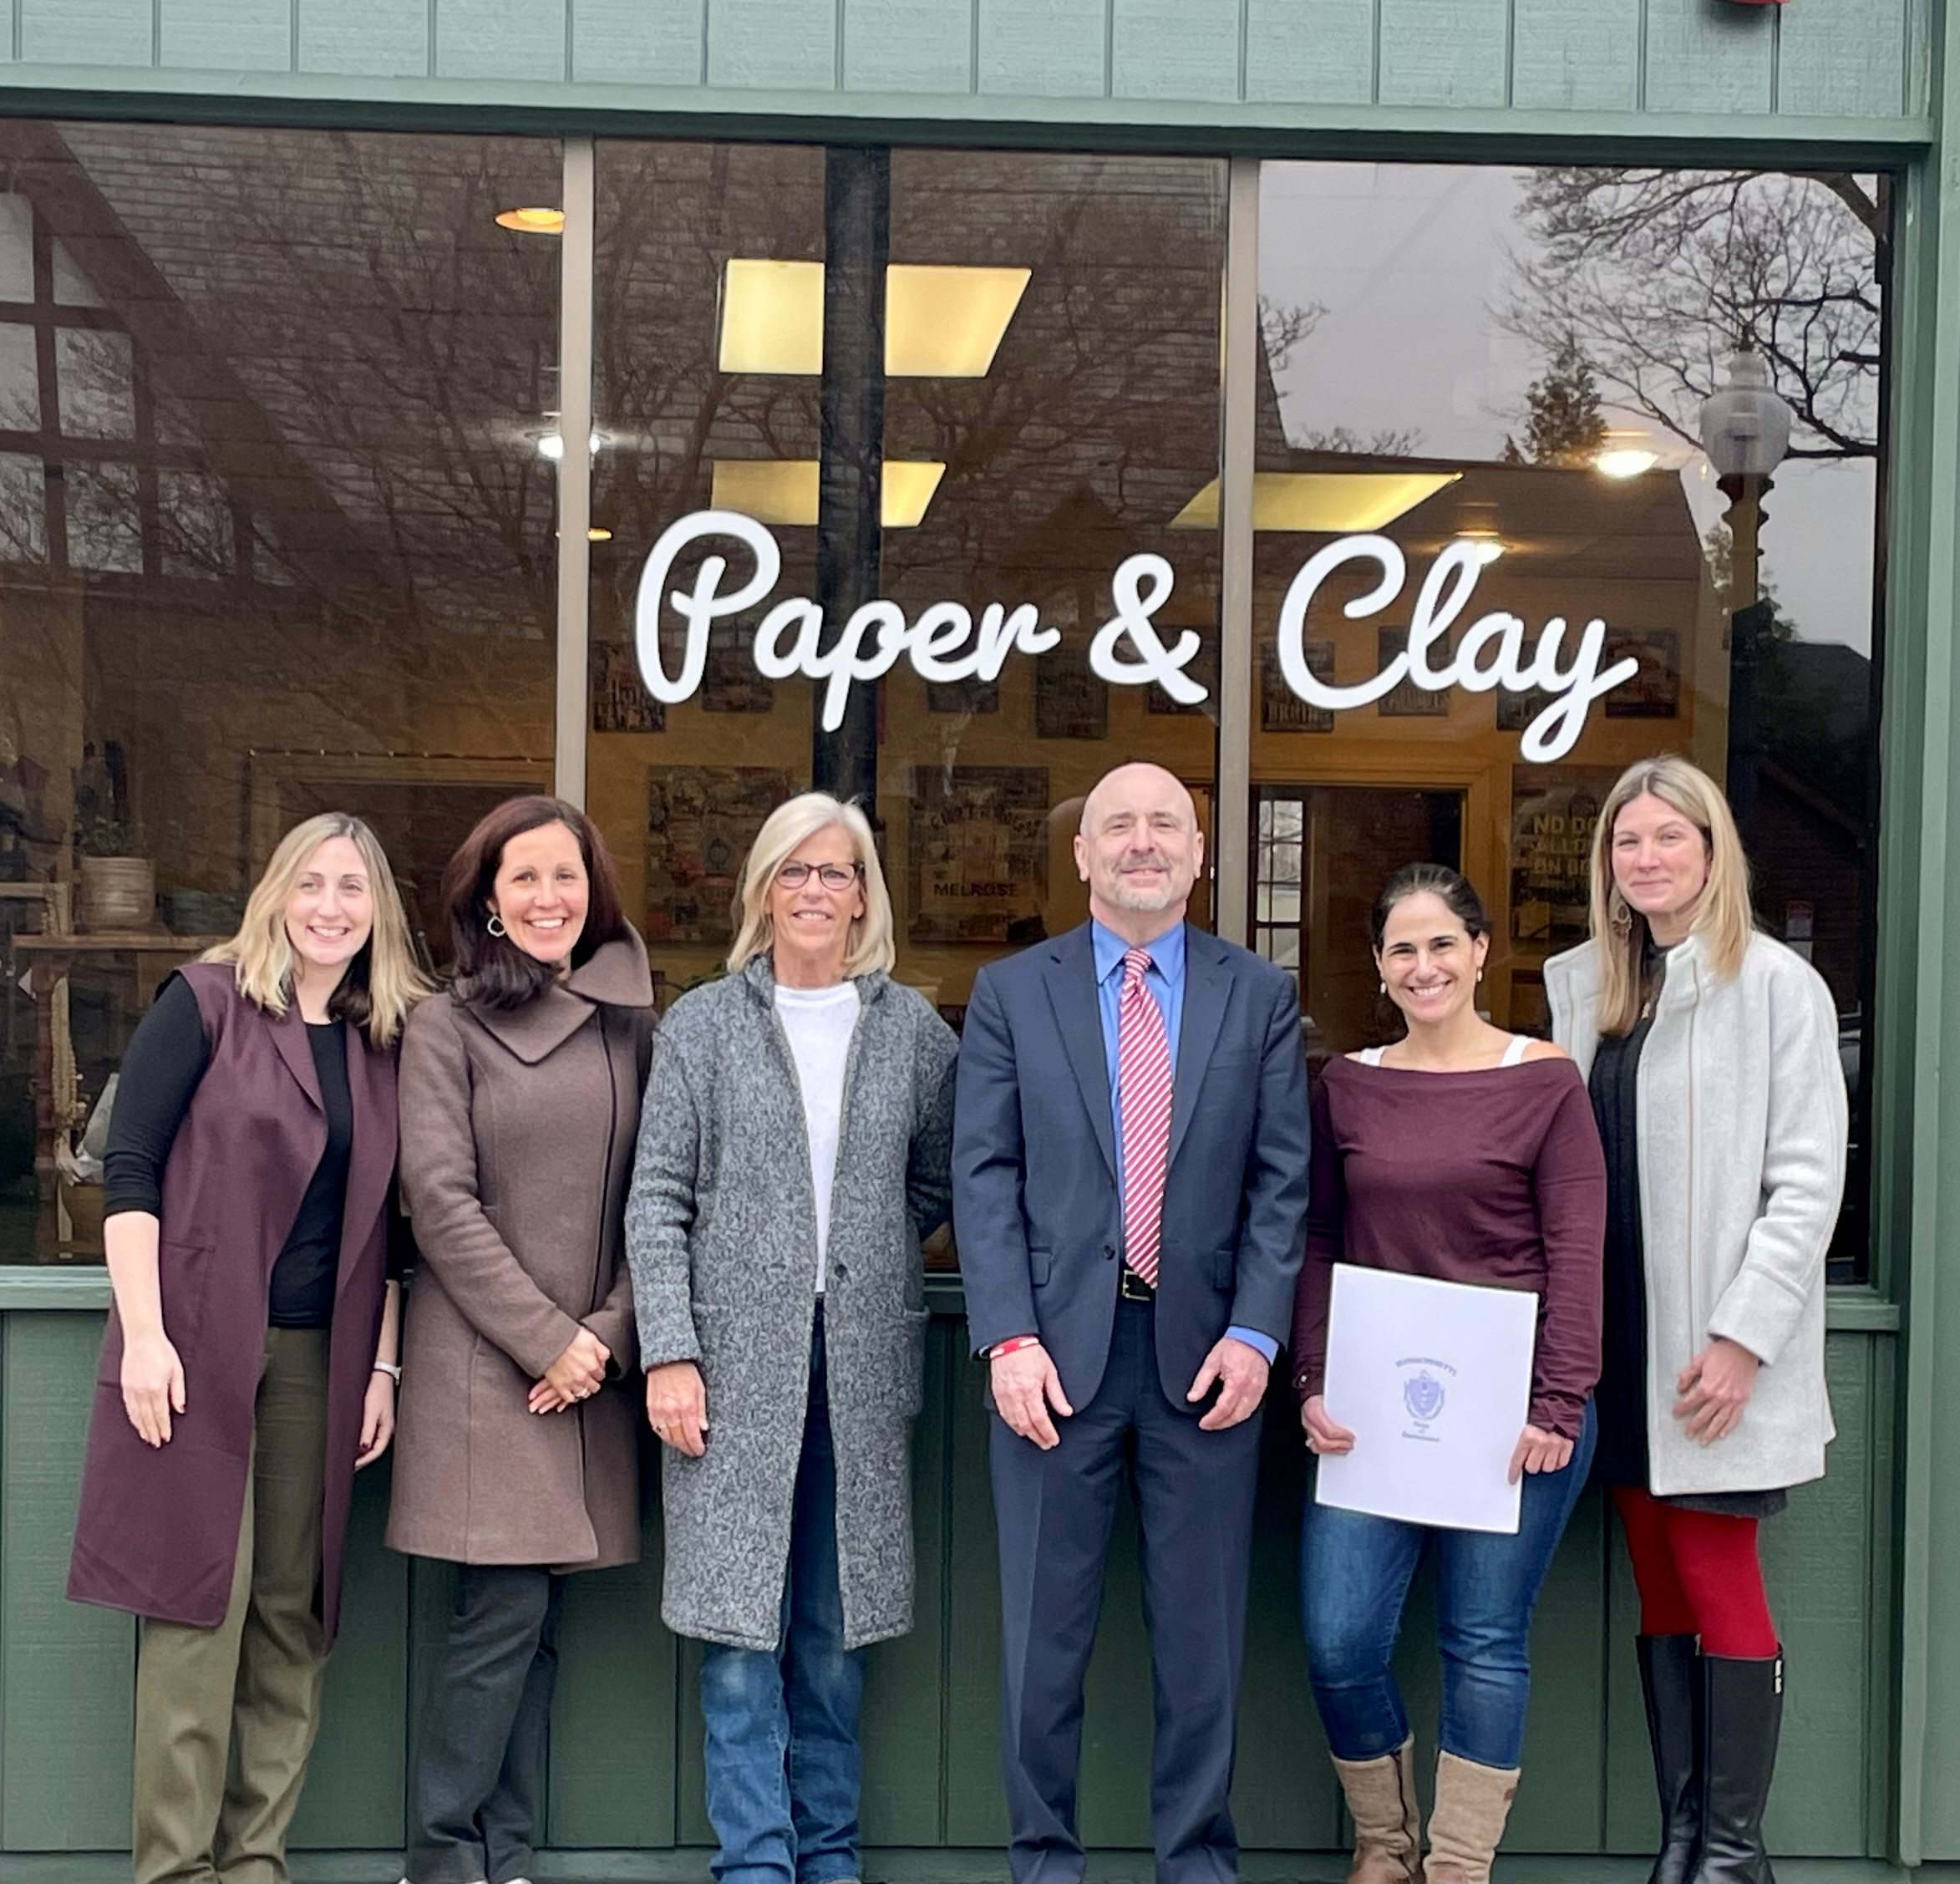

Slide 25
In 2022 We Cared for the Environment
202 trees planted
11 recycling events
Sustainability and Recycling Days
Home improvements for a Better Climate
EV Charger Event
EV 101 Webinar
Heat Pump 101 Webinar
Sustainable Saturdays
Earth Week Clean Up

Slide 27
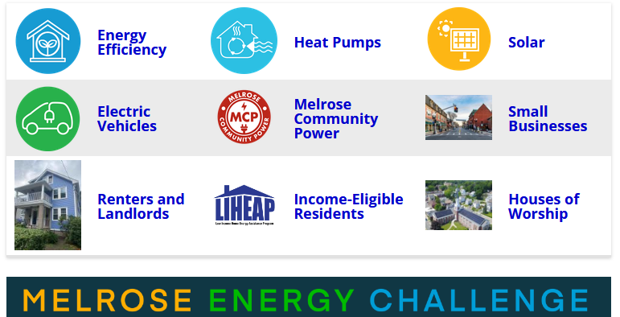

Slide 30
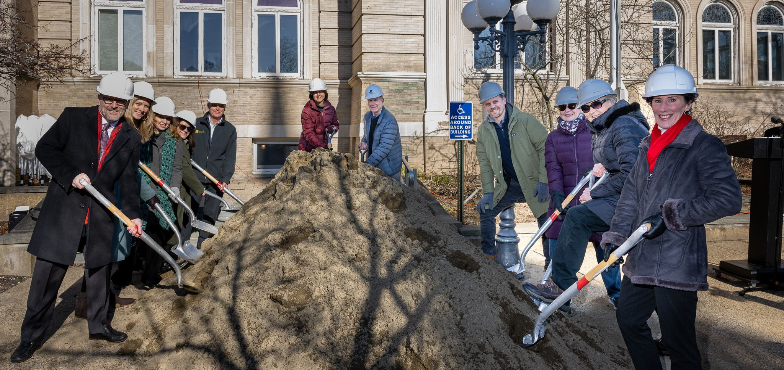
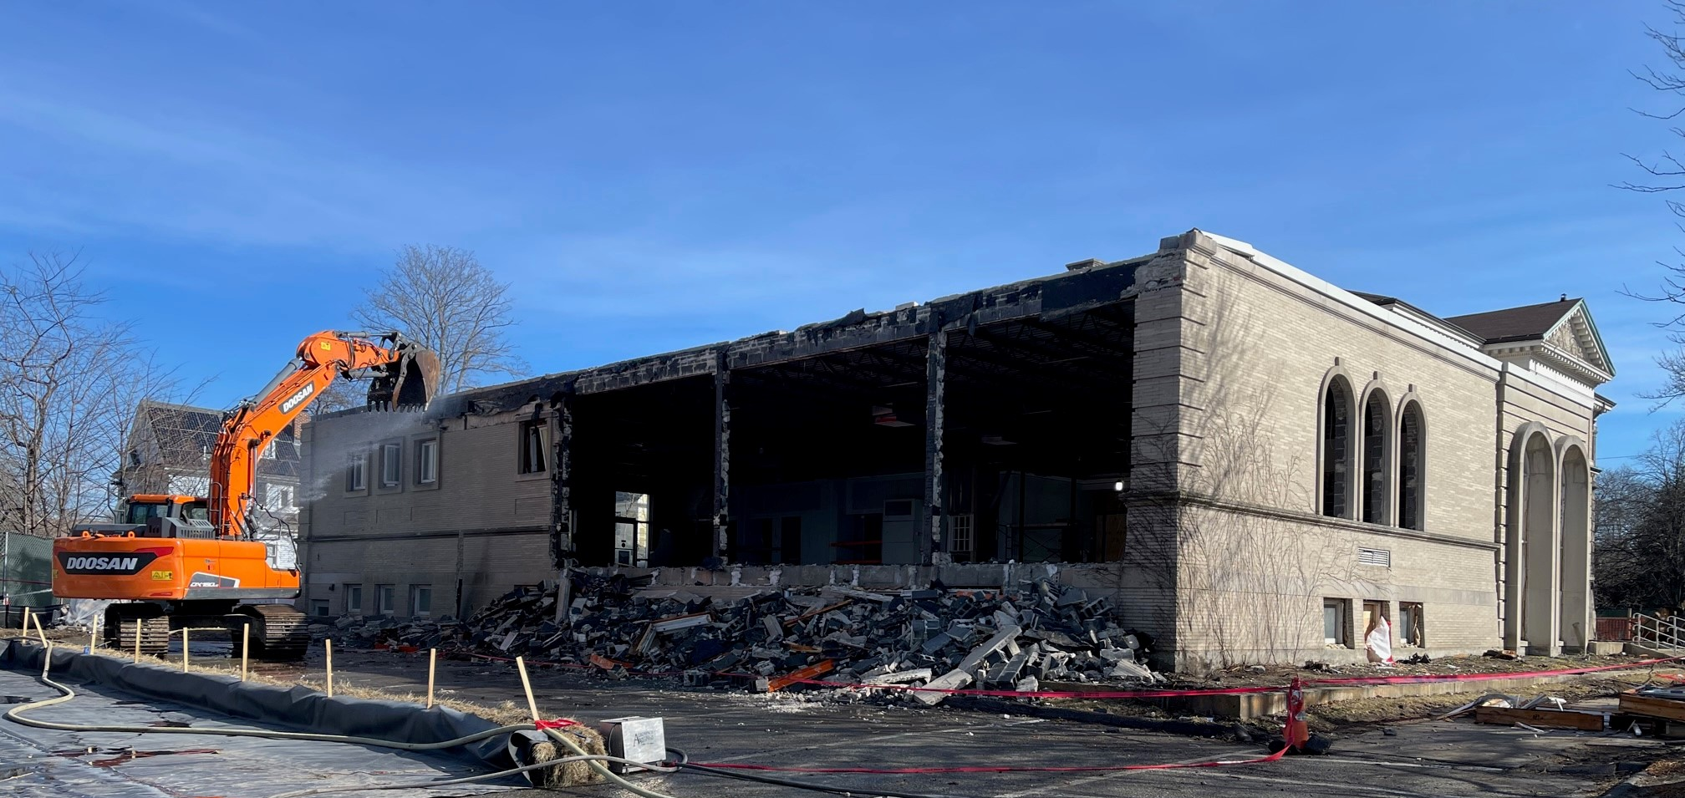
Library renovation groundbreaking

Slide 31
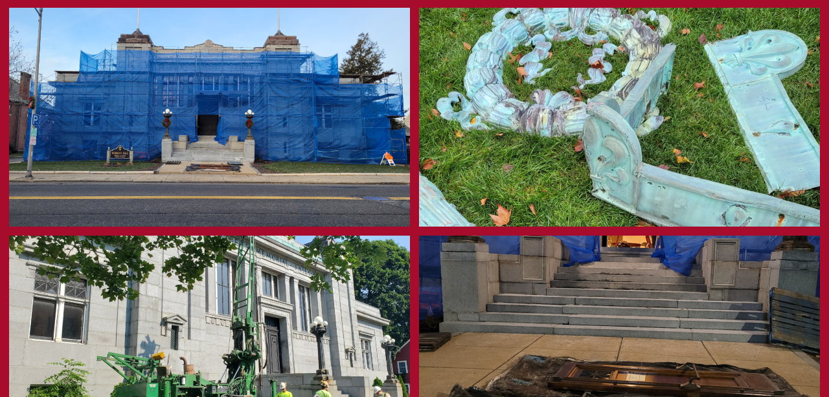
Memorial hall restoration

Slide 32
In 2022 We Invested in Infrastructure
High School Elevators
School Roof Replacement
MVMMS Air Conditioning Project
Franklin School windows
Fred Green Field Turf Fabric Replacement
High School Bathroom Upgrades
Lead water service line replacement

Slide 33
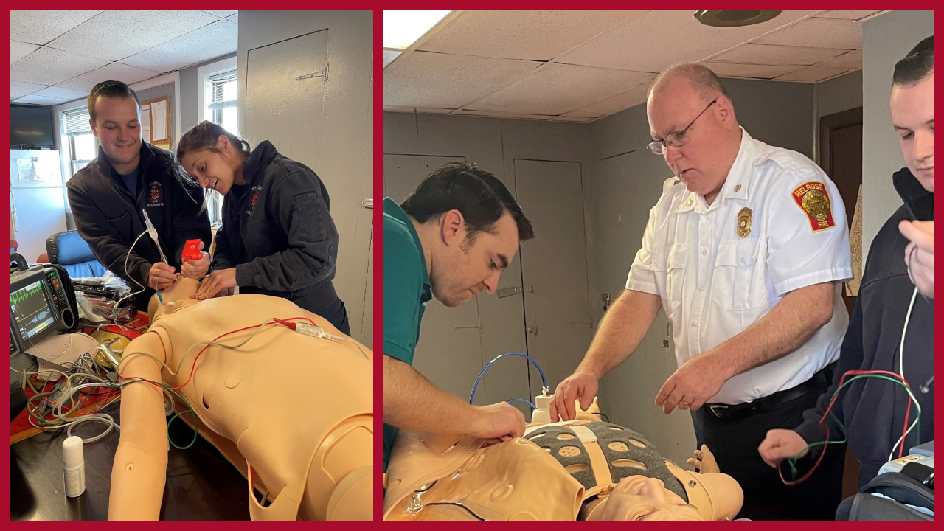
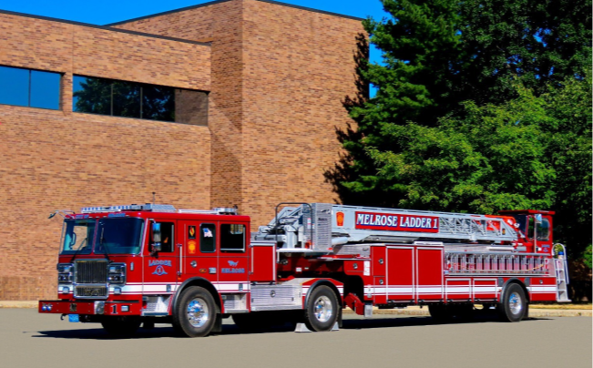
Public safety infrastructure
City Hall emergency backup generator
Fire Station HVAC Upgrade
Pumper tuck
Ladder Truck
Fire Department Life Safety Apparatus
Fire Department Training Equipment

Slide 34
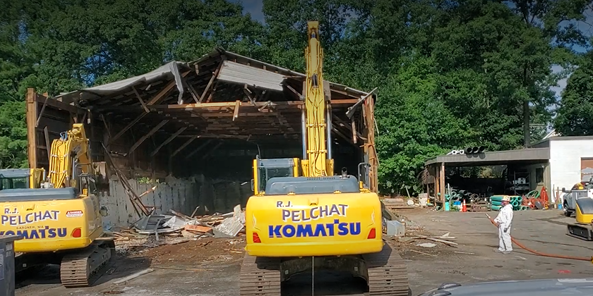
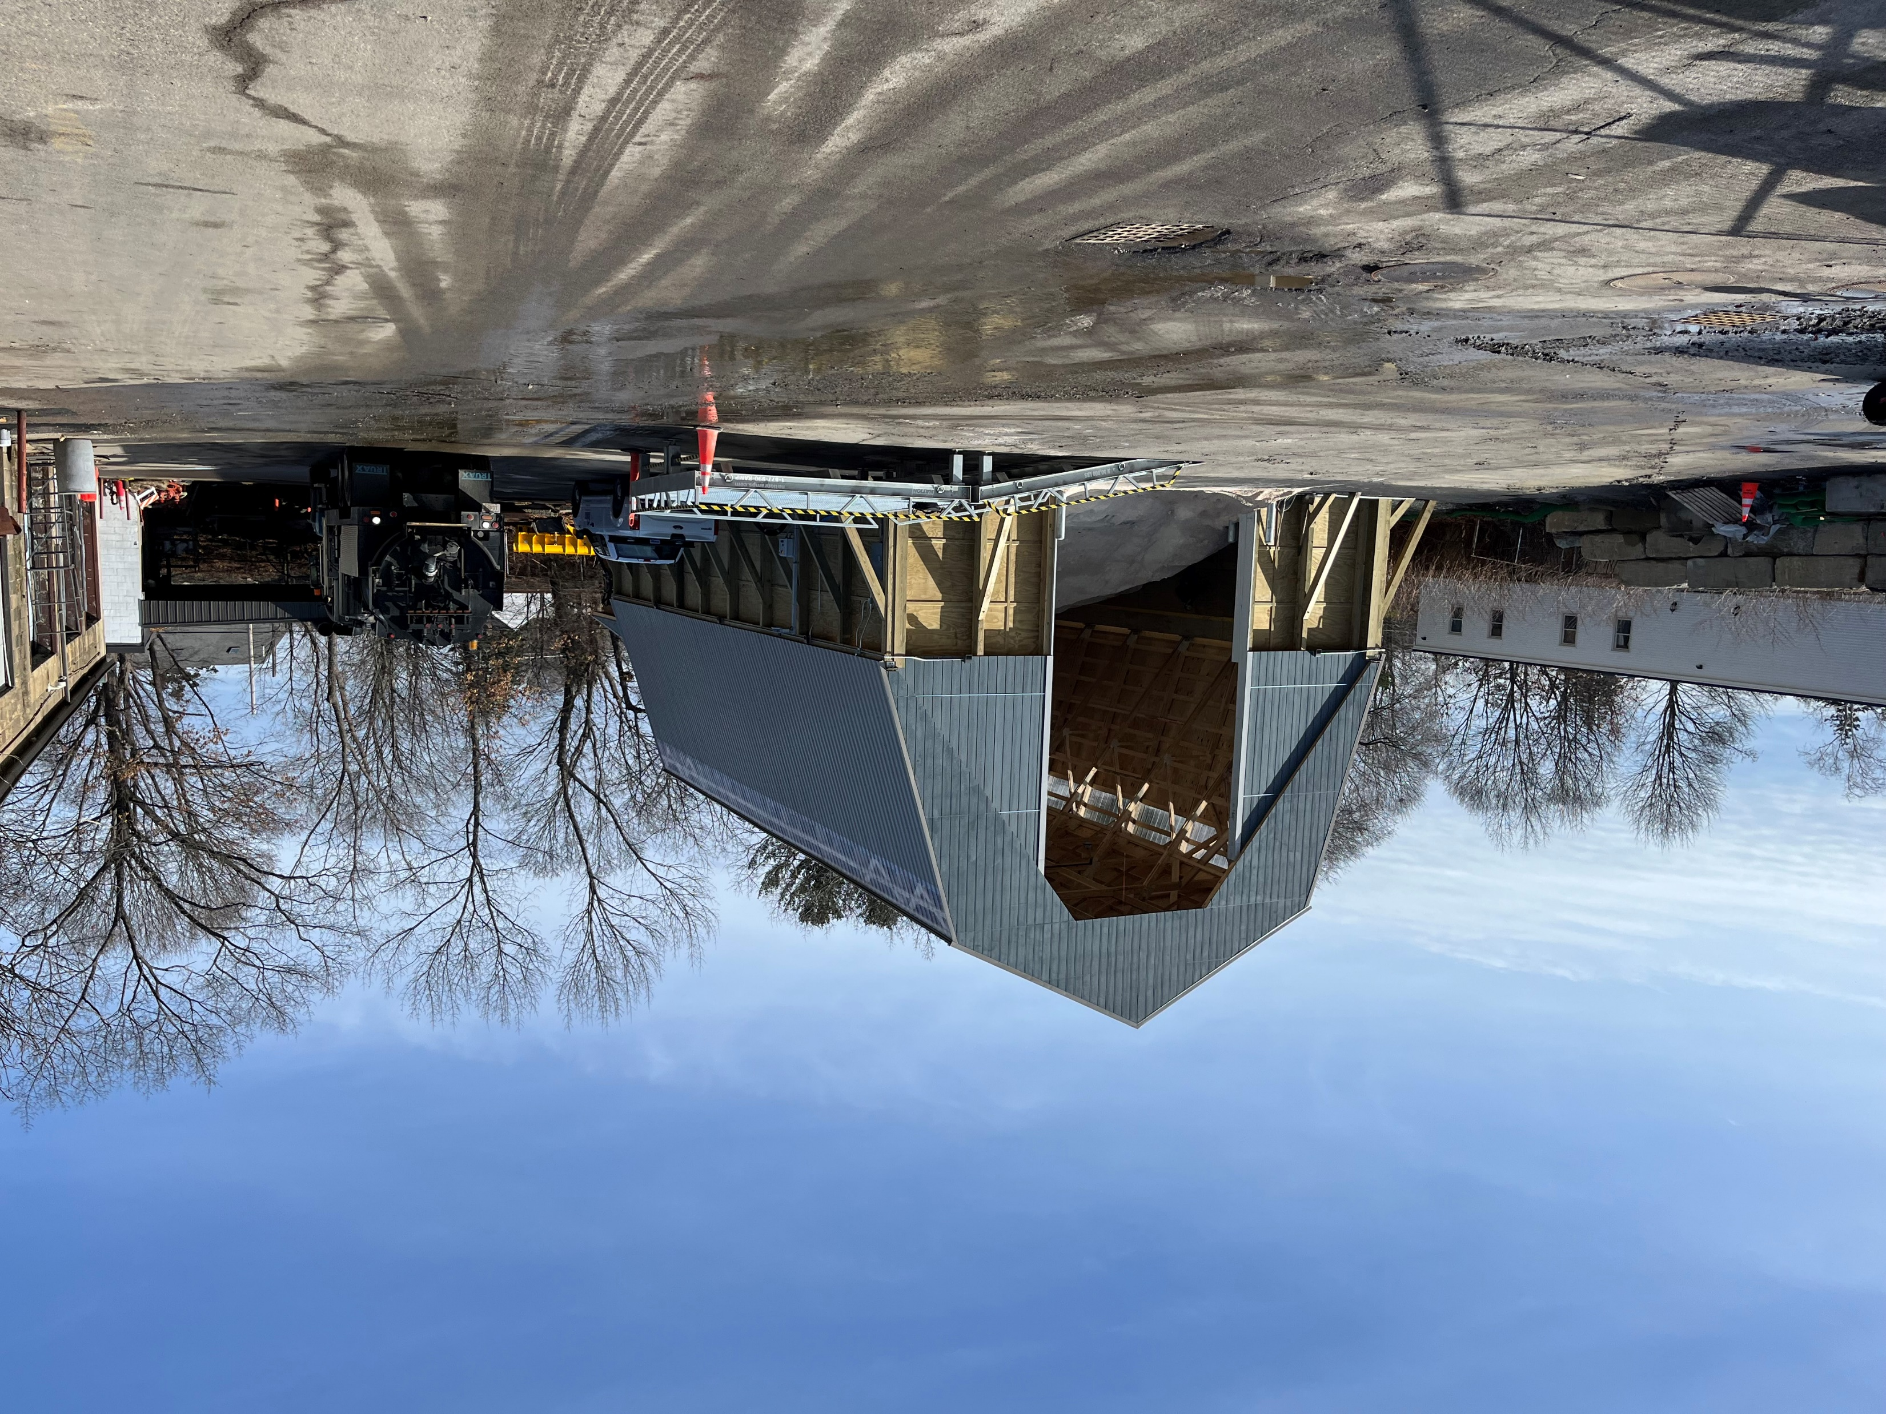
2022
2023
DPW CITY YARD Salt Shed replacement

Slide 35
We made Improvements to Our Parks and Open Spaces
LEBANON FIELD RENOVATION
FOSS PARK PICKLEBALL AND BASKETBALL COURTS
ELL POND BRIDGE CONSTRUCTION
AMAZING GRACE BASKETBALL COURT
VOLUNTEER PARK INCLUSIVE PLAYGROUND

Slide 36
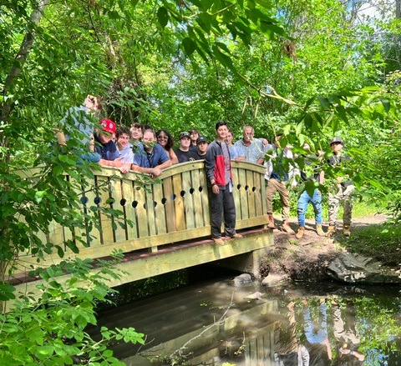

Slide 37
State and federal grant funding
$1 million Stop School Violence Grant
$1 million federal ear mark for Ell Pond climate resiliency
$100K State economic development earmark for placemaking
$100K State earmark for Memorial Hall repairs
$500K Green Community Building Grant for Library decarbonization
$615K MassWorks Grant for caruso’s redevelopment
$150K State earmark for fire hq
$150K for High School elevatoRS
And more!

Slide 38
State and federal grant funding
Housing Choice Grant
Massachusetts Office of Disability Grant​
State Budget Earmarks for New Fire Equipment
Massachusetts School Building Authority Accelerated Repair Grant
Community Compact Grants for Capital Planning & Fleet Management​
National Grid Grant for the Melrose Energy Challenge

Slide 39
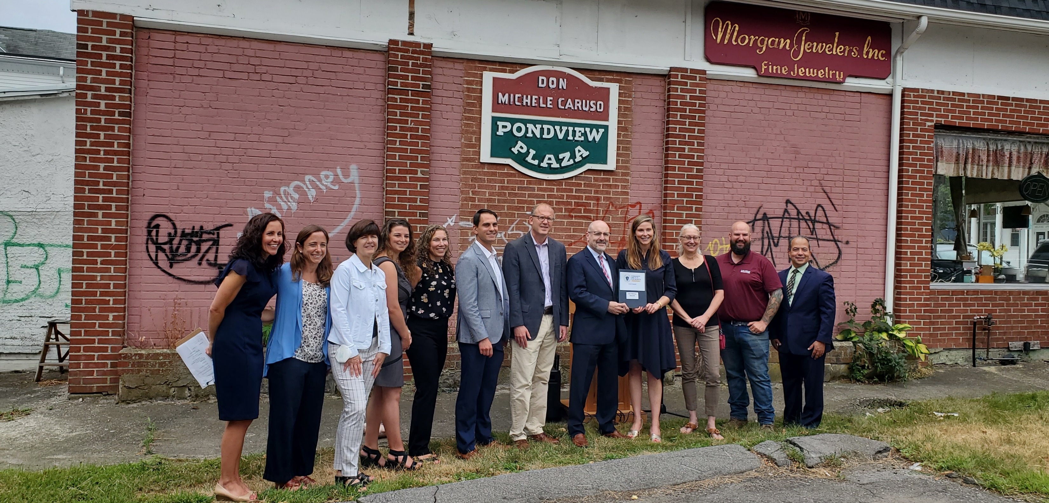

Slide 40
Facing challenges together

Slide 41
City finances
CHALLENGES
Tight Labor Market
Inflation
STRENGTHS
Reserves
State Aid
Federal Relief Funds
School Budget Increases
AA+ Bond Rating

Slide 42
Net State Aid increase

Slide 43
We Have Been Planning for the Future
ADA Self-Assessment and Transition Plan
Capital Investment Strategy
Fleet Electrification
Net Zero Implementation
Municipal Vulnerability Preparedness
Age and Dementia-Friendly Community Designation planning
Housing Production Plan
Open Space Plan
Public Safety Building Project planning
Notes:
“Melrose has consistently taken a lead when it comes to combatting greenhouse gas emissions, protecting our natural resources, ensuring sustainable practices, and promoting energy efficiency. Since 2009, Melrose has adopted more than 450 solar rooftops and seen a 25% reduction in emissions because of our fuel-efficient vehicle policy, and more. I am proud of what Melrose has accomplished, but there are broader, bolder steps to take. I look forward to working with the community, my colleagues, and local and state entities to complete this important work.”

Slide 45
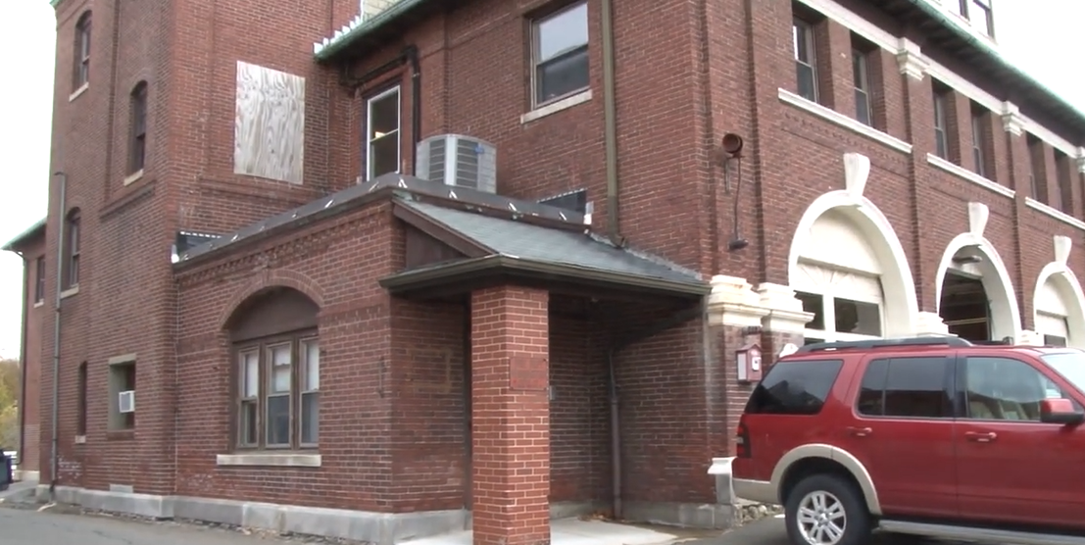
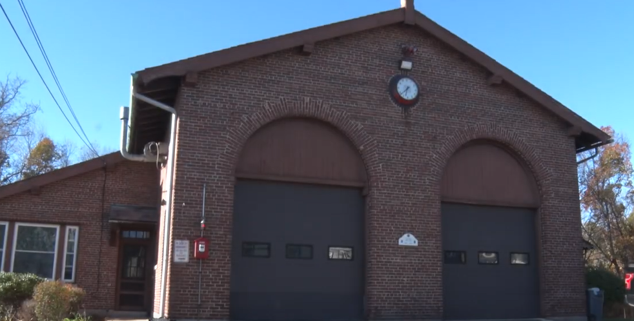
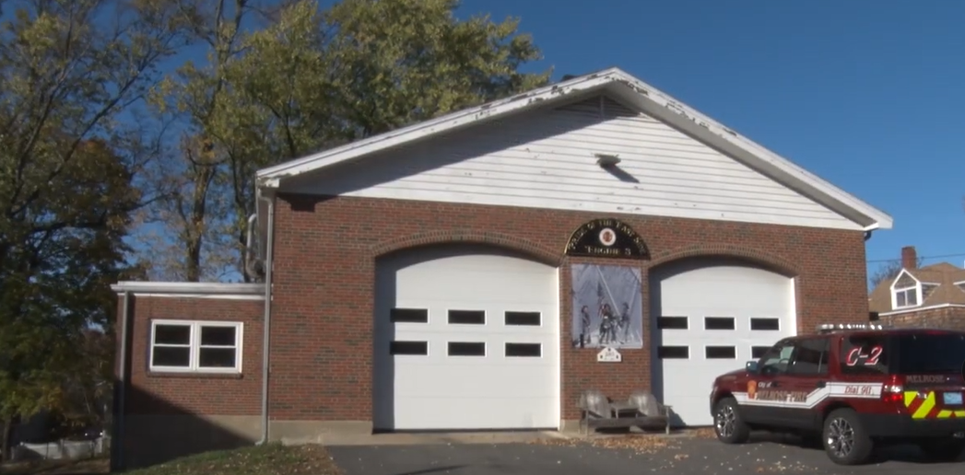
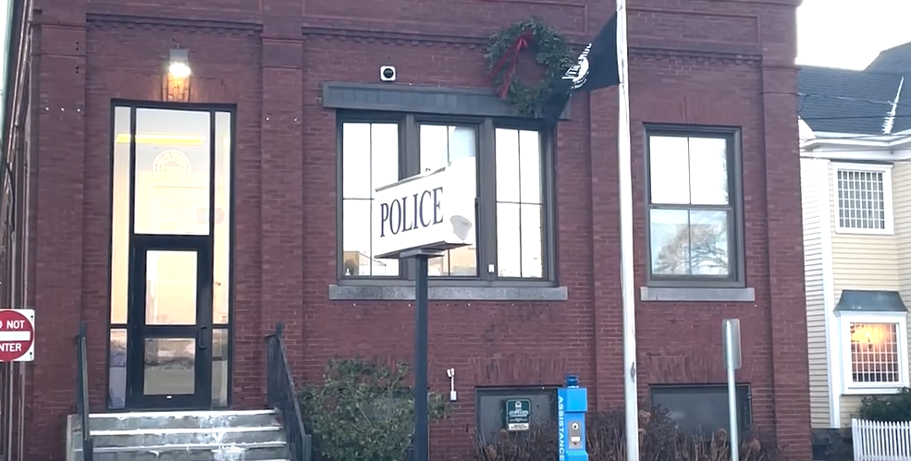
Fire Headquarters, Built 1889
Melrose Highlands Fire Station, Built 1929
East Side Fire Station, Built 1964
Melrose Police Station, Built 1900

Slide 46
www.melrosepsb.org

Slide 47
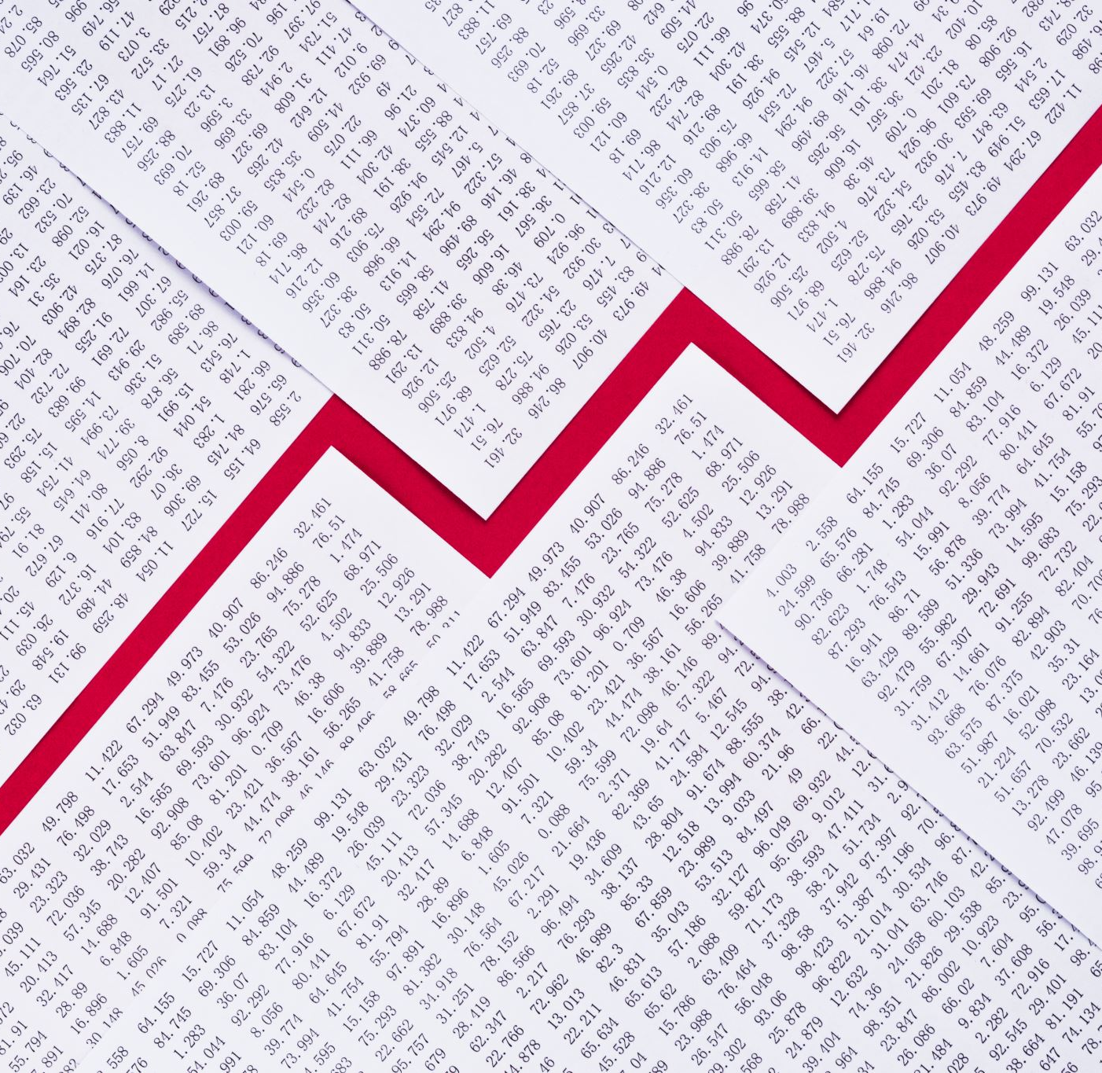
Growing our tax base

Slide 48
Investments in Placemaking and Public Art

Slide 49
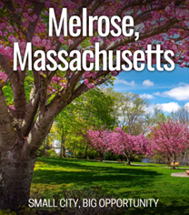
Attracting new businesses

Slide 50
Looking to our shared future

Slide 51
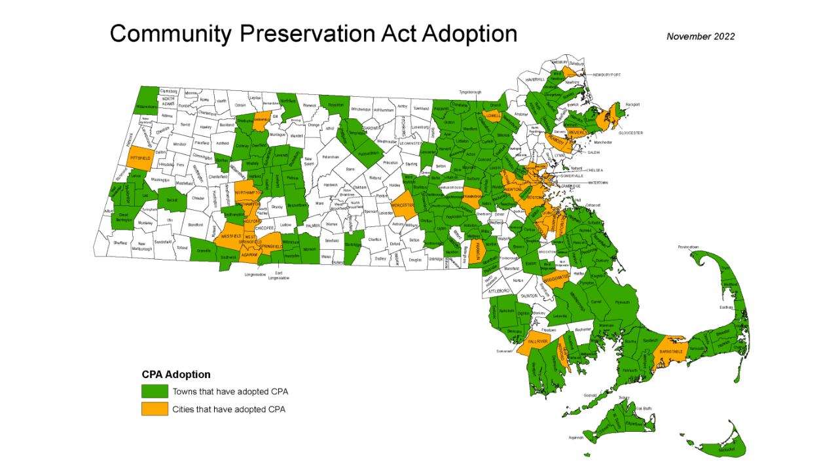

Slide 52
commitment to progress on our community goals

Slide 53
Melrose Vision 2030
“There is no power for change greater than a community discovering what it cares about.”
– Margaret Wheatley

Slide 54
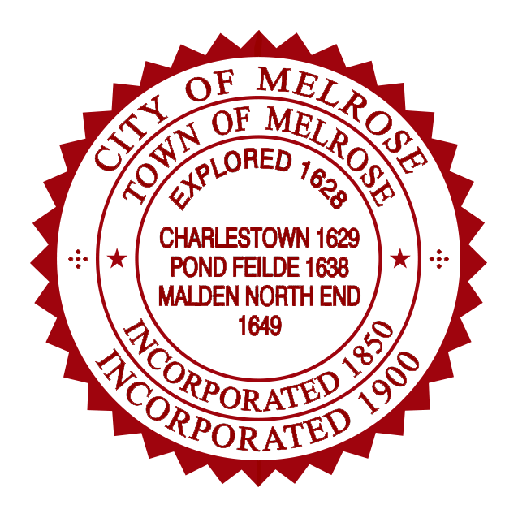
thank you melrose!

